Slide 1
C# program
Using - Import deklarationer
Namespace
Klasser
Metoder
Statements og expressions
Kommentarer
Notes:
Main metode er ikke nødvendig for libraries.

Slide 2
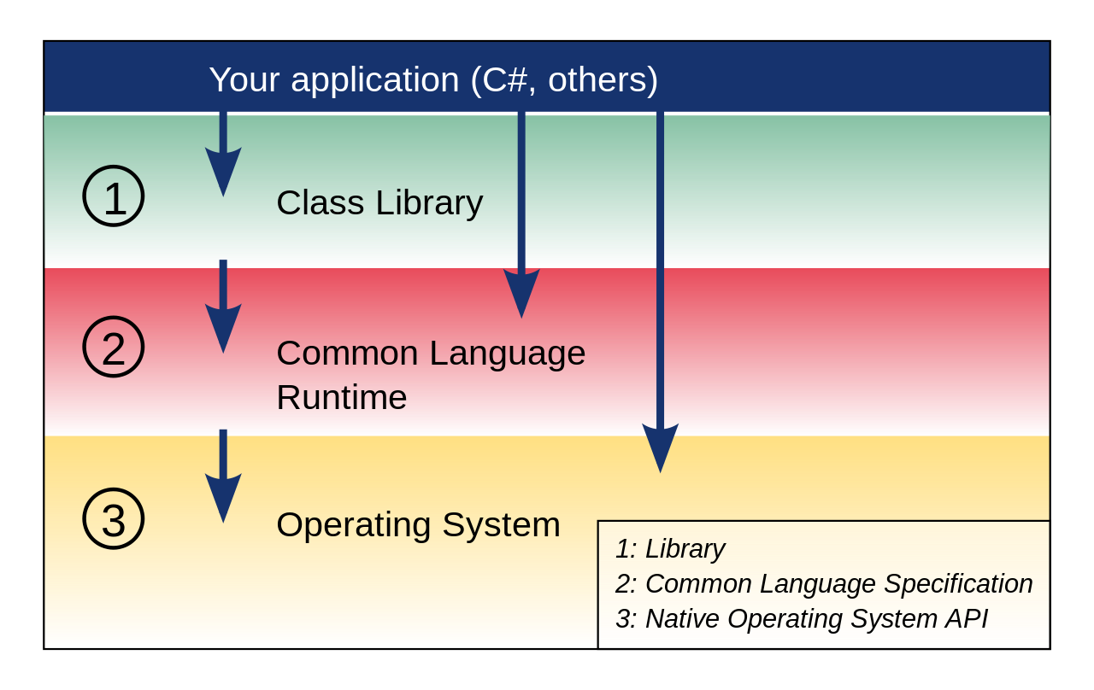
.net CLI
Common Language Infrastructure

Slide 3
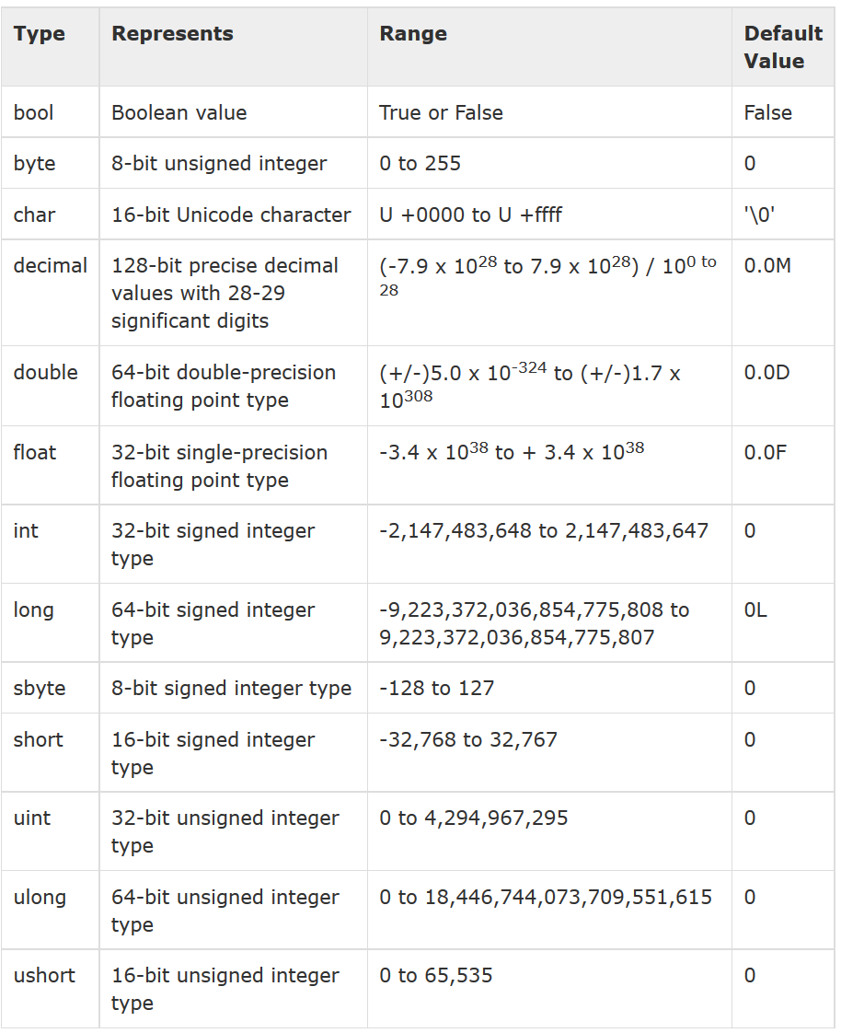
Datatyper

Slide 4
Variables and Constants
int x = 1; // x holds the value 1 x = 2; // now x holds the value 2
int answer = 42; string greeting = "Hello, World!"; double bigNumber = 1e100; System.Console.WriteLine("{0} {1} {2}", answer, greeting, bigNumber);
// A constant is another type of field.
// It holds a value that is assigned when the program is compiled, and never changes after that.
const int speedLimit = 55;

Slide 5
Loops
string[] array2 = {"hello", "world"}; foreach (string s in array2) { System.Console.WriteLine(s); }
// An array of strings string[] array2 = {"hello", "world"}; for (int i=0; i<2; i++) { System.Console.WriteLine(array2[i]); }
// An array of strings string[] array2 = {"hello", "world"}; int y = 0; while (y < 2) { System.Console.WriteLine(array2[y]); y++; }
// An array of strings string[] array2 = {"hello", "world"}; int y = 0; do { System.Console.WriteLine(array2[y]); y++; }

Slide 6
Classes
using System; class SampleClass { public void SayHello() { Console.WriteLine("Hello, World!"); } } class Program { // Main is the entry point, where every C# program starts. static void Main(string[] args) { // Create an object. SampleClass sampleClass1 = new SampleClass(); // Call a method. sampleClass1.SayHello(); } }

Slide 7
Namespace
namespace StatisticalData
{ class FileHandling { public void Load() {} // code to load statistical data }
} namespace Images { class FileHandling { public void Load() {} // code to load an image file } } class Program { static void Main() { StatisticalData.FileHandling data = new StatisticalData.FileHandling(); data.Load(); Images.FileHandling image = new Images.FileHandling(); image.Load(); } }

Slide 8
C# Program
// A Hello World! program in C# using System; namespace HelloWorld { class Hello { static void Main() { System.Console.WriteLine("Hello World!"); // Keep the console window open in debug mode. System.Console.WriteLine("Press any key to exit."); System.Console.ReadKey(); } } }

